Slide 1
How do we minister to women with same sex attraction?
Sue bohlin | suebohlin.com | @suebohlin

Slide 2

Gender Spectrum

Slide 3


Slide 4
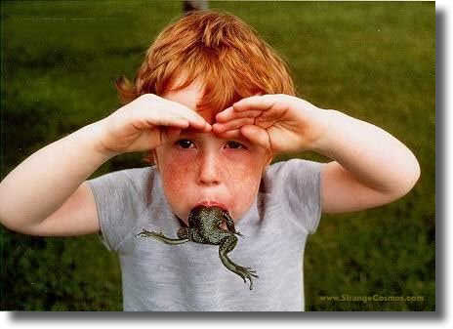
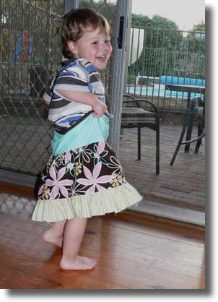
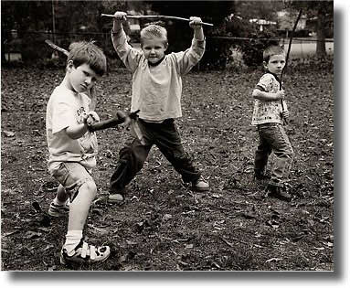
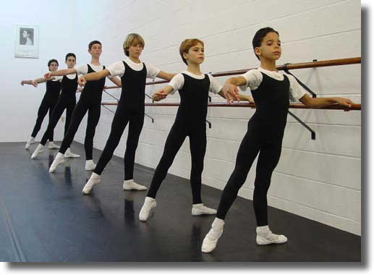
Rough-and-tumble. . . . . . . . . . . . . . . . . . . . . . . Sensitive/creative
Masculinity
Spectrum

Slide 5
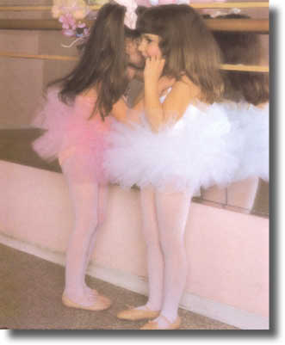
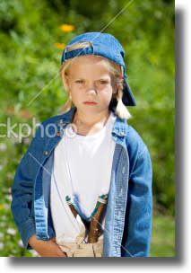
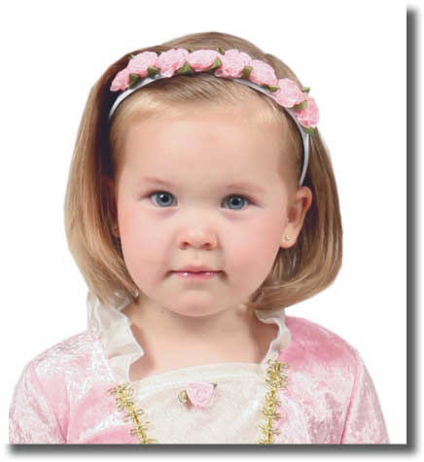
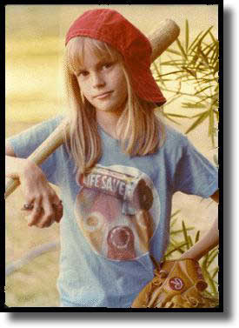
Girly-girl. . . . . . . . . . . . .Tomboy-GIRL
Femininity
Spectrum

Slide 6
Sexual and Relational Brokenness Continuum
Bull Dyke
Butch
Bi
Sexual
Ever
Straight
Lipstick Lesbian
Transgender
Promiscuous Women
Pan Sexual

Slide 7


Bull Dyke
Butch
Bi
Sexual
Ever
Straight
Lipstick Lesbian
Transgender
Promiscuous Women
Pan Sexual
EVER-STRAIGHT

Slide 8
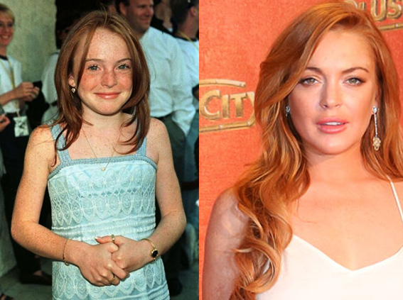
  LINDSAY LOHAN

Slide 9
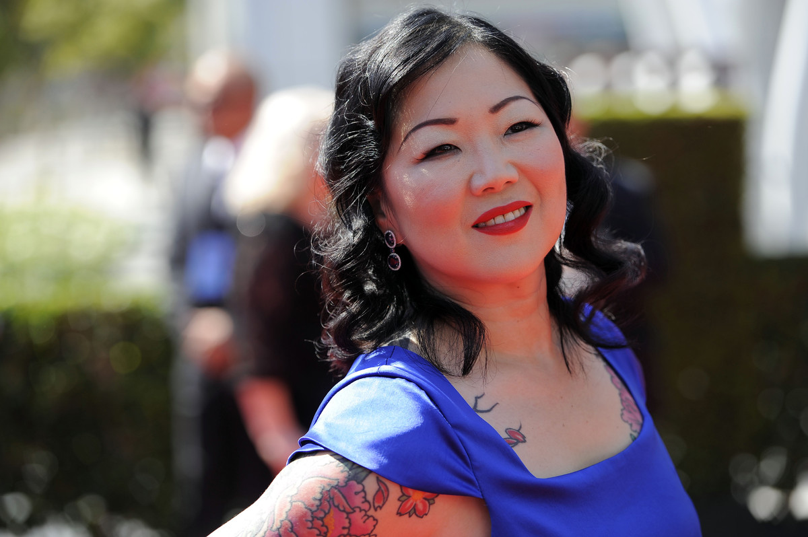
MARGARET CHO

Slide 10
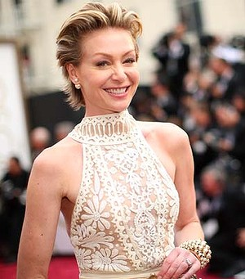
PORTIA DI ROSSI

Slide 11
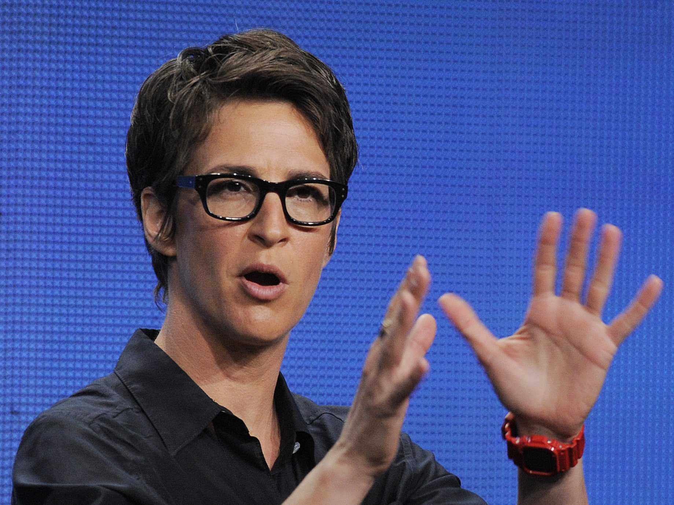
RACHEL MADDOW

Slide 12
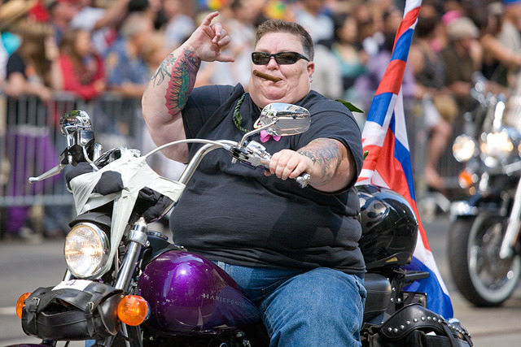
BULL DYKE

Slide 13
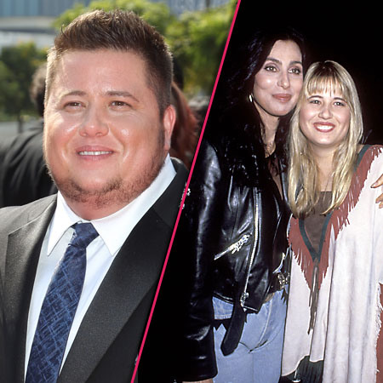
CHASTITY / CHAZ BONO

Slide 14
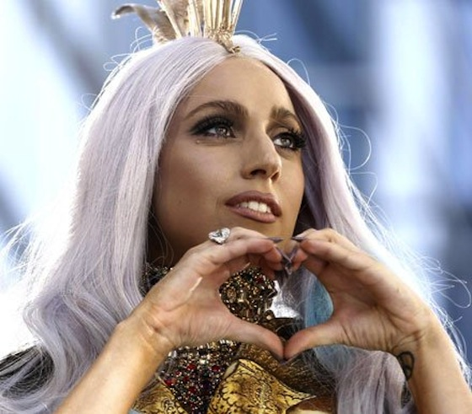
LADY GAGA

Slide 15

“OTHER THAN”

Slide 16
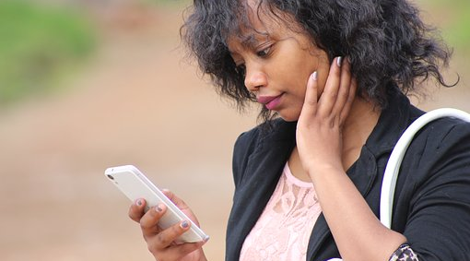
PORN USE
PORN USE

Slide 17
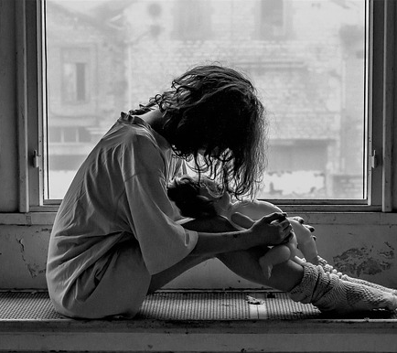
SEXUAL ABUSE

Slide 18

No connection to friends

Slide 19

Attention affection affirmation
UNMET NEEDS FOR THE 3 As

Slide 20

Emotional dependence

Slide 21

CULTURAL SHIFT

Slide 22

The solution: Love one another

