Slide 1
Freedom from Our Past
Sue Bohlin
Cruise Retreat 2017
@suebohlin

Slide 2
Tootle the Train

Slide 3
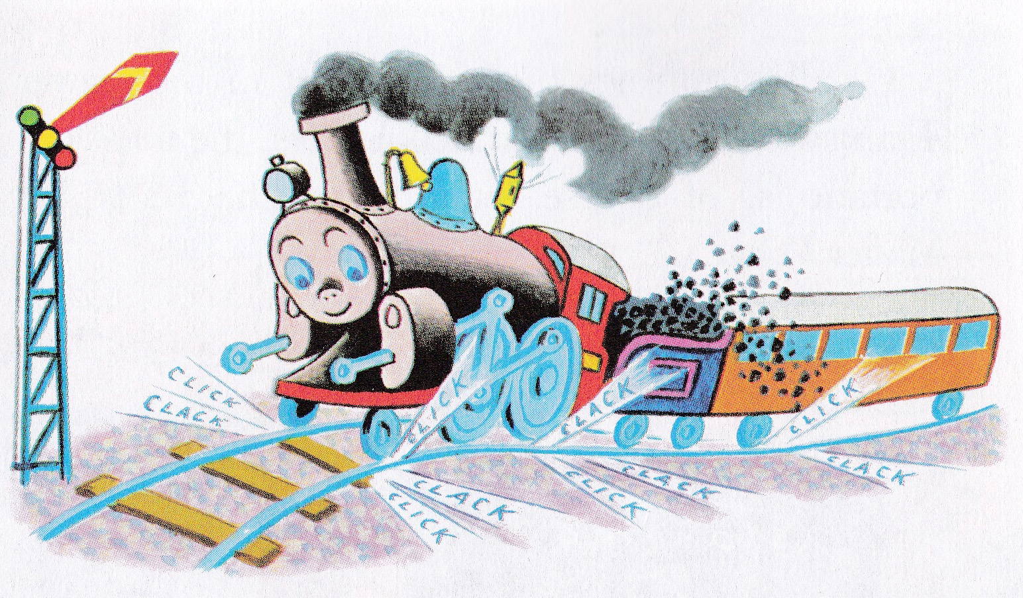
Notes:
Far, far to the west of everywhere is the village of Lower Trainswitch. All the baby locomotives go there to learn to be big locomotives. The young locomotives steam up and down the tracks, trying to call out the long, sad ToooOoooot of the big locomotives. But the best they can do is a gay little Tootle.
Lower Trainswitch has a fine school for engines. There are lessons in Whistle Blowing, Stopping for a Red Flag Waving, Puffing Loudly When Starting, Coming Around Curves Safely, Screeching When Stopping, and Clicking and Clacking Over the Rails.

Slide 4
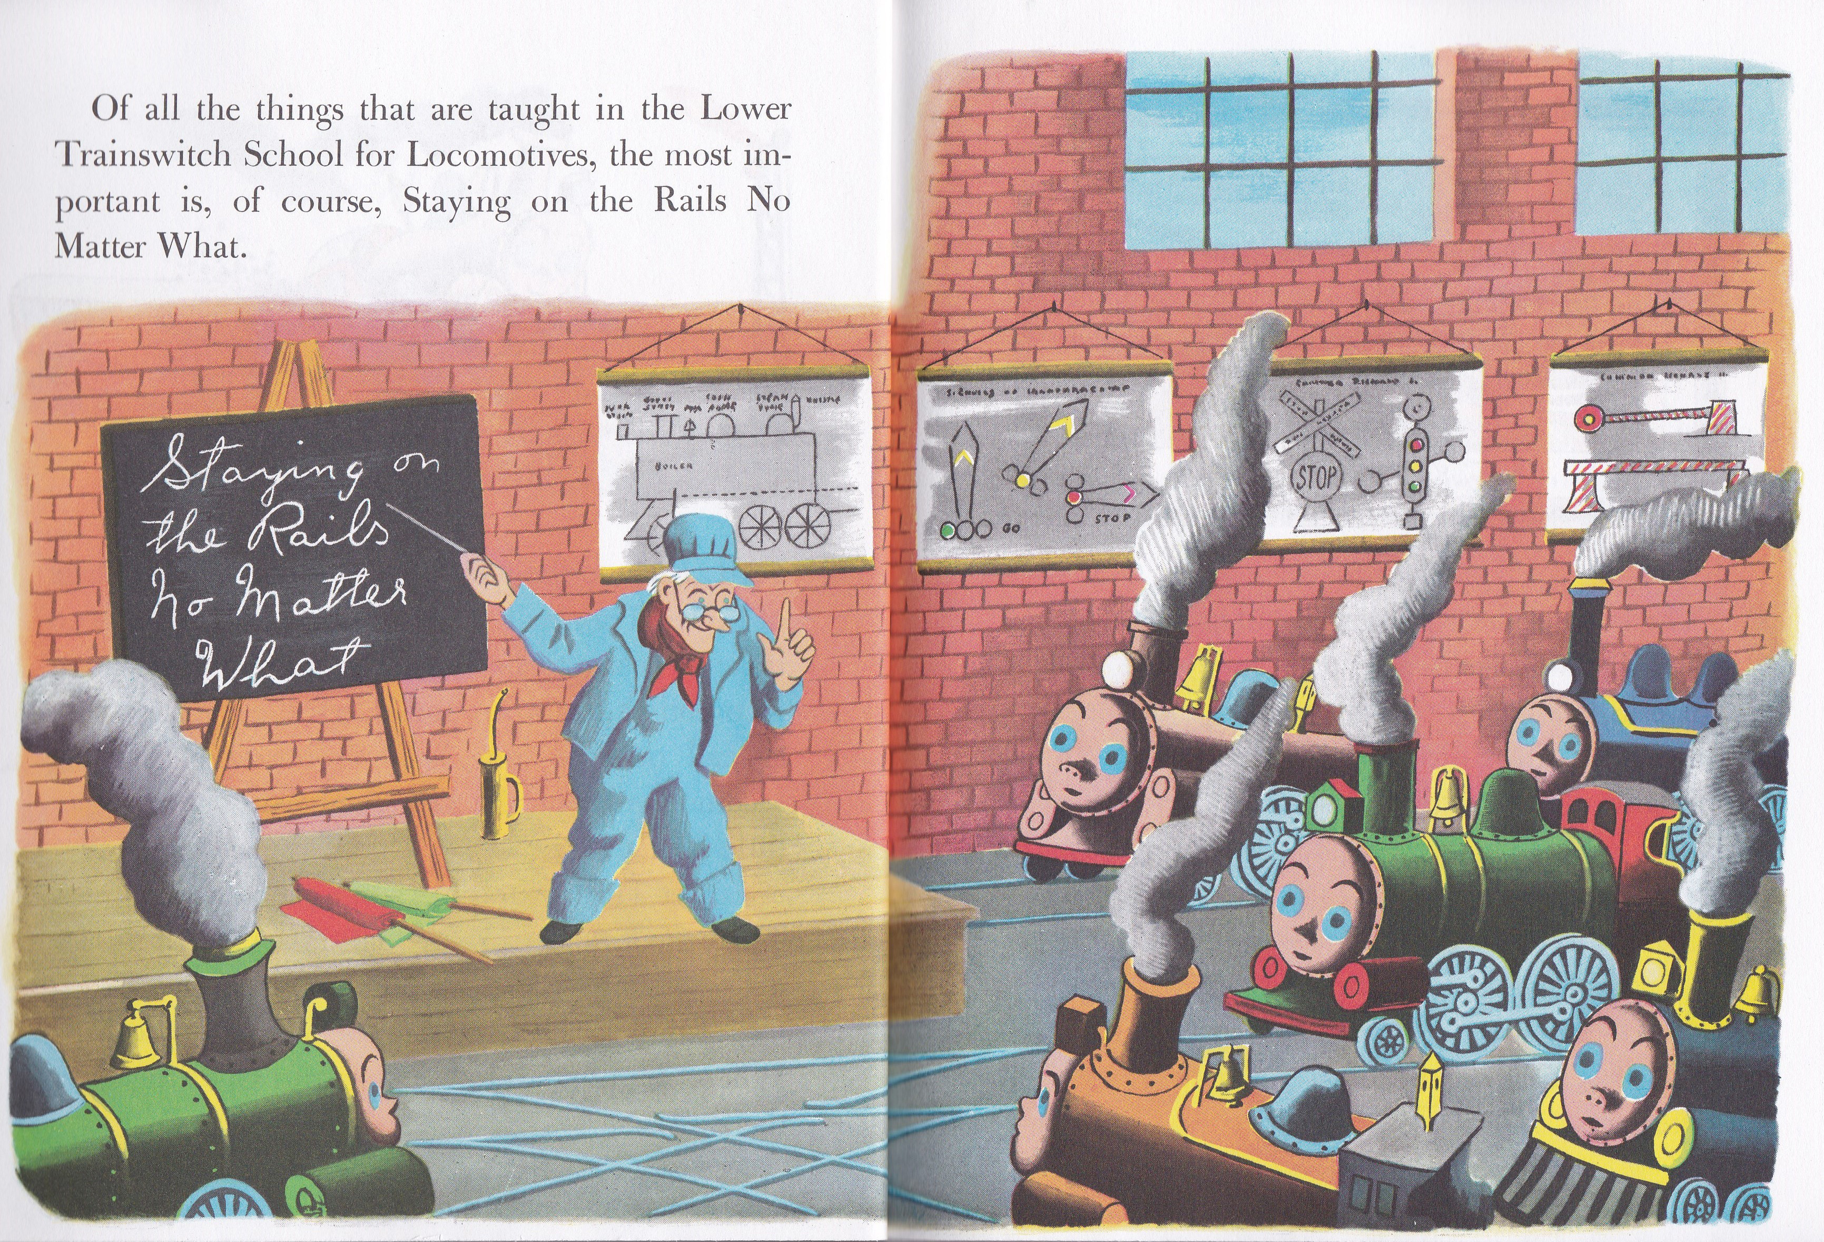
Notes:
Of all the things that are taught in the Lower Trainswitch School for Locomotives, the most important is, of course, Staying on the Rails No Matter What.

Slide 5
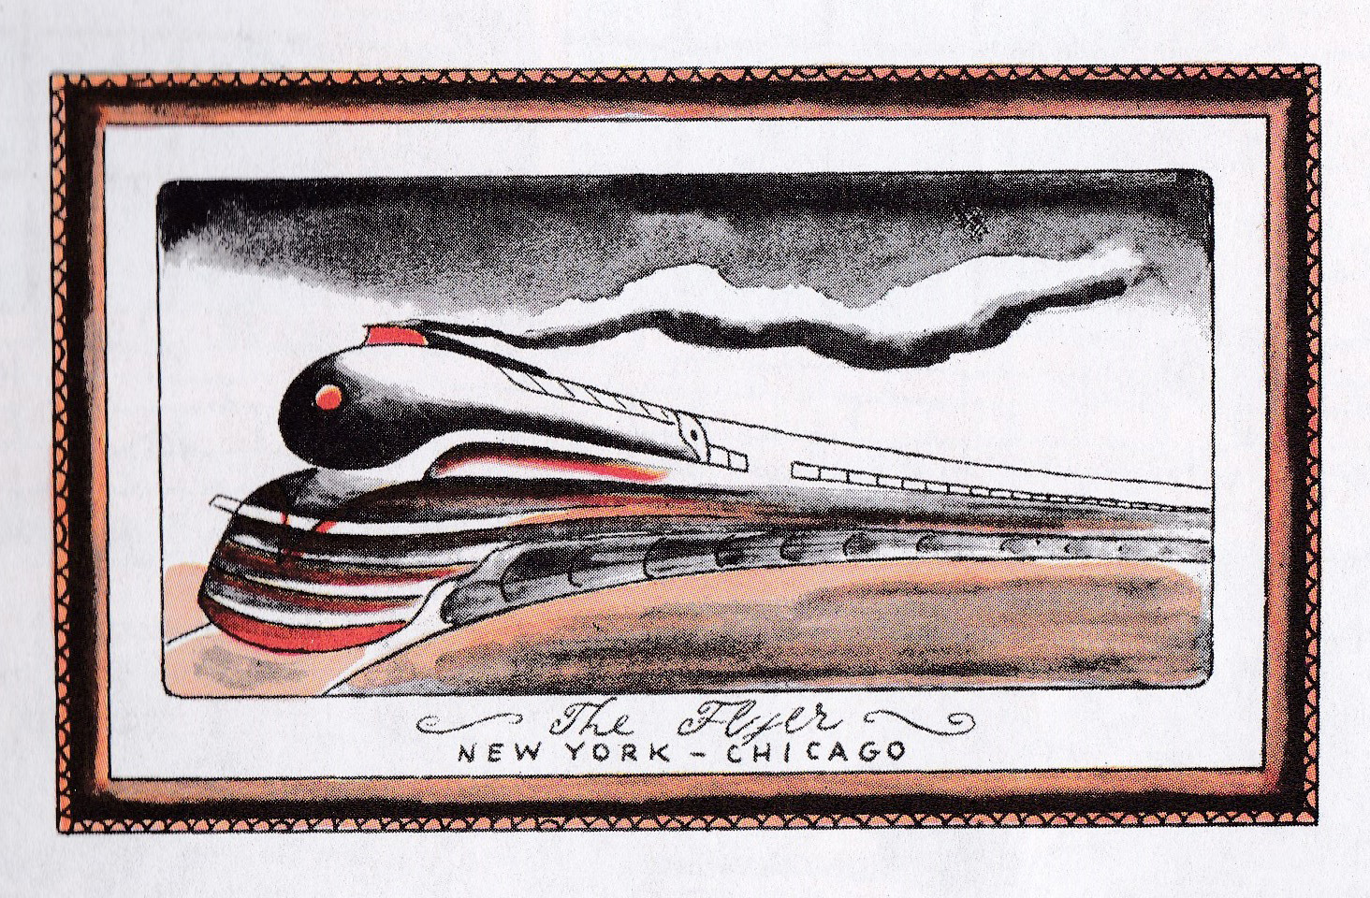
Notes:
The head of the school is an old engineer named Bill. Bill always tells the new locomotives that they will never, never be good trains unless they get 100 A+ in Staying on the Rails No Matter What. All the baby engines work very hard to get 100 A+ in Staying On the Rails. After a few weeks not one of the engines in the Lower Trainswitch School for Trains would even think of getting off the rails, no matter – well, no matter what.

Slide 6
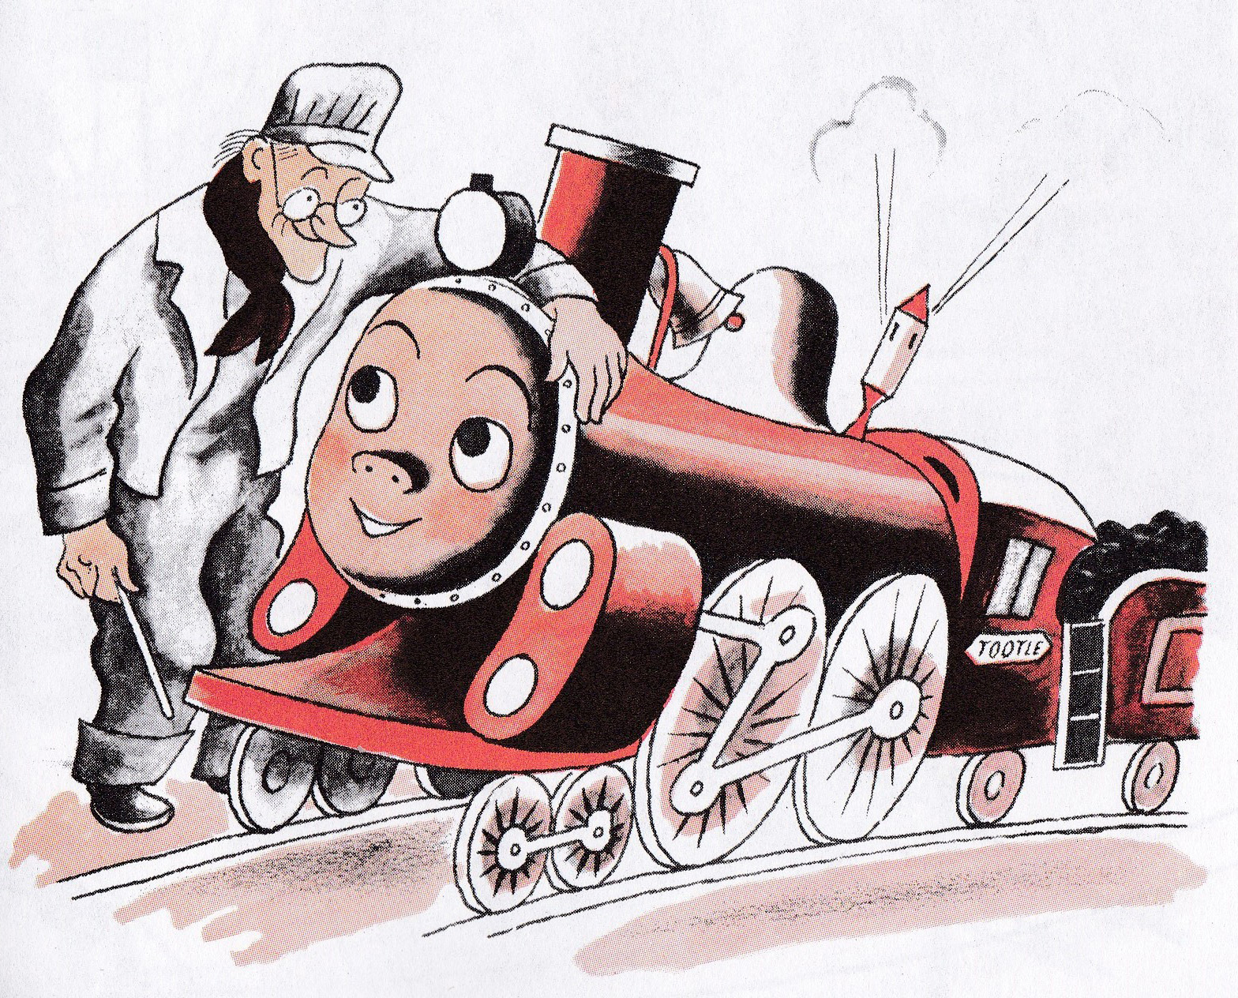
Notes:
One day a new locomotive named Tootle came to school.
“Here is the finest baby I’ve seen since old 600,” thought Bill. He patted the gleaming young locomotive and said, “How would you like to grow up to be the Flyer between New York and Chicago?”
“If a Flyer goes very fast, I should like to be one,” Tootle answered. “I love to go fast. Watch me.”

Slide 7
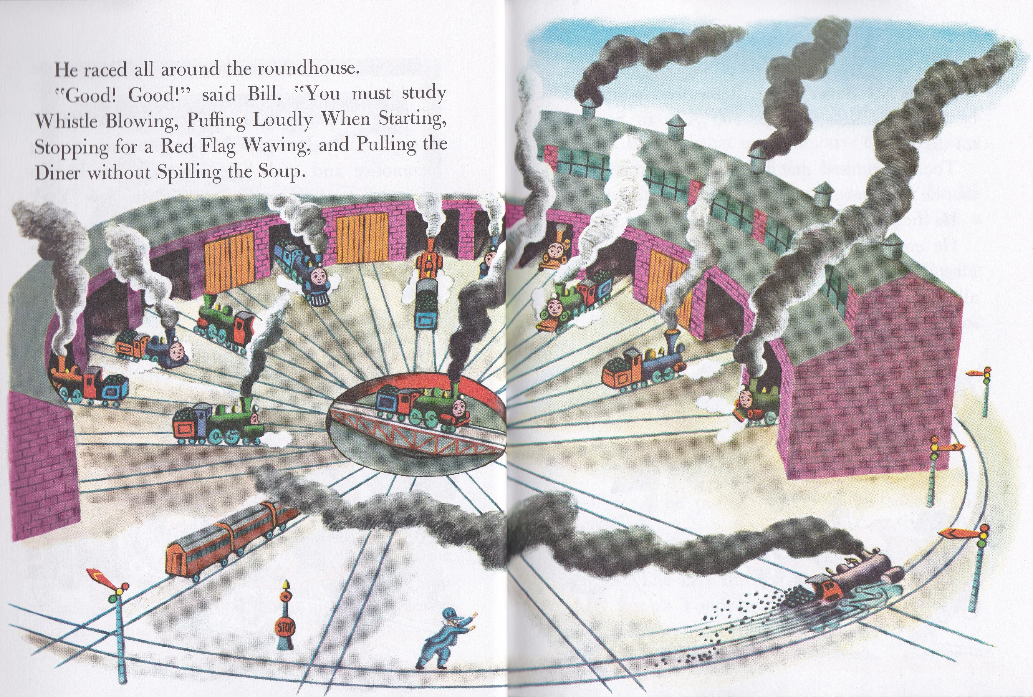
Notes:
He raced all around the roundhouse.
“Good! Good!” said Bill. “You must study Whistle Blowing, Puffing Loudly When Starting, Stopping for a Red Flag Waving, and Pulling the Diner without Spilling the Soup.

Slide 8
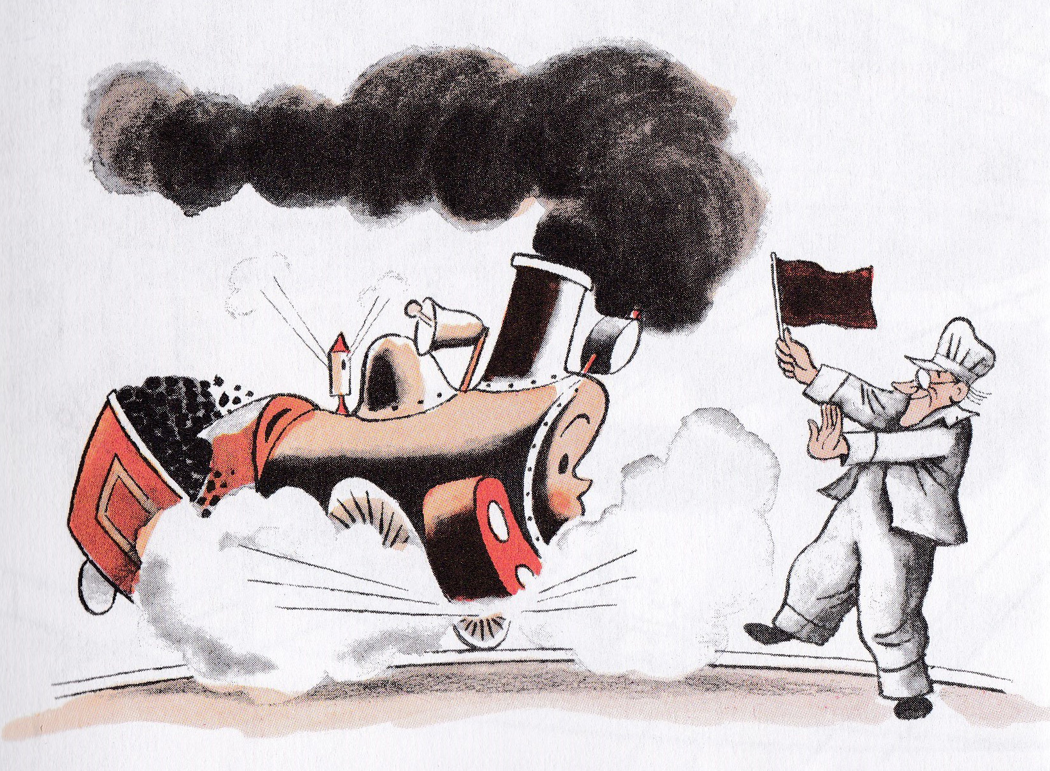
Notes:
“But most of all you must study Staying on the Rails No Matter What. Remember, you can’t be a Flyer unless you get 100 A+ in Staying on the Rails.”
Tootle promised that he would remember and that he would work very hard.
He did, too.
He even worked hard at Stopping for a Red Flag Waving, Tootle did not like those lessons at all. There is nothing a locomotive hates more than stopping.

Slide 9
Notes:
But Bill said that no locomotive ever, ever kept going when he saw a red flag waving.
One day, while Tootle was practicing for his lesson in Staying on the Rails No Matter What, a dreadful thing happened.
He looked across the meadow he was running through and saw a fine, strong black horse,
“Race you to the river,” shouted the black horse, and kicked up his heels.
“If I am going to be a Flyer, I can’t let a horse beat me,” he puffed. “Everyone at school will laugh at me.”
His wheels turned so fast that they were silver streaks. And just as Tootle was sure he could win, the tracks made a great curve.

Slide 10
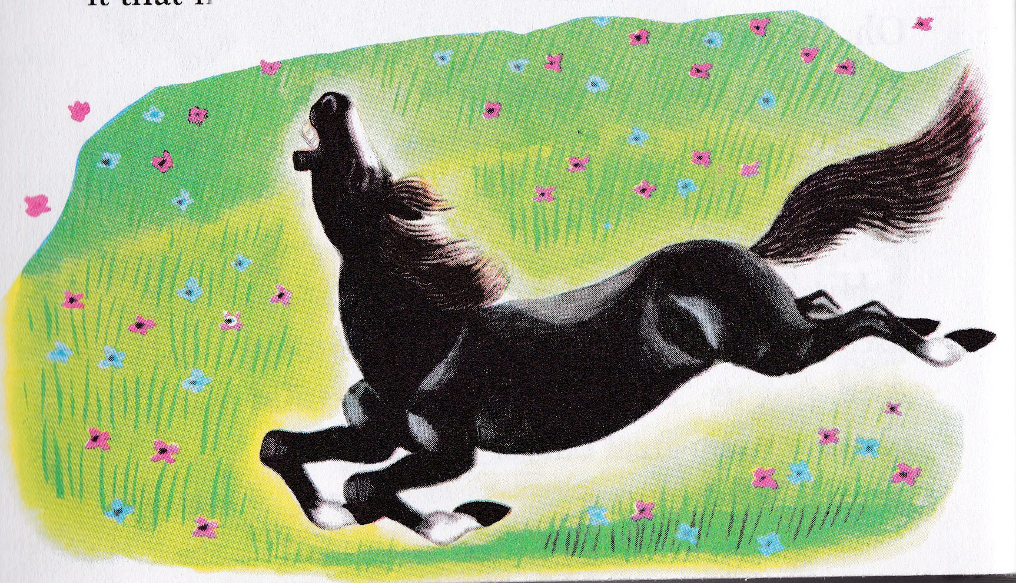
Notes:
“Oh, Whistle!” cried Tootle. “That horse will beat me now. He’ll run straight while I’ll take the Great Curve.”
Then the Dreadful Thing happened, After all that Bill had said about Staying on the Rails No Matter What, Tootle jumped off the tracks and raced alongside the black horse!
The race ended in a tie. Both Tootle and the black horse were happy.
When Tootle got back to school, he said nothing about leaving the rails. But he thought about it that night in the roundhouse.

Slide 11
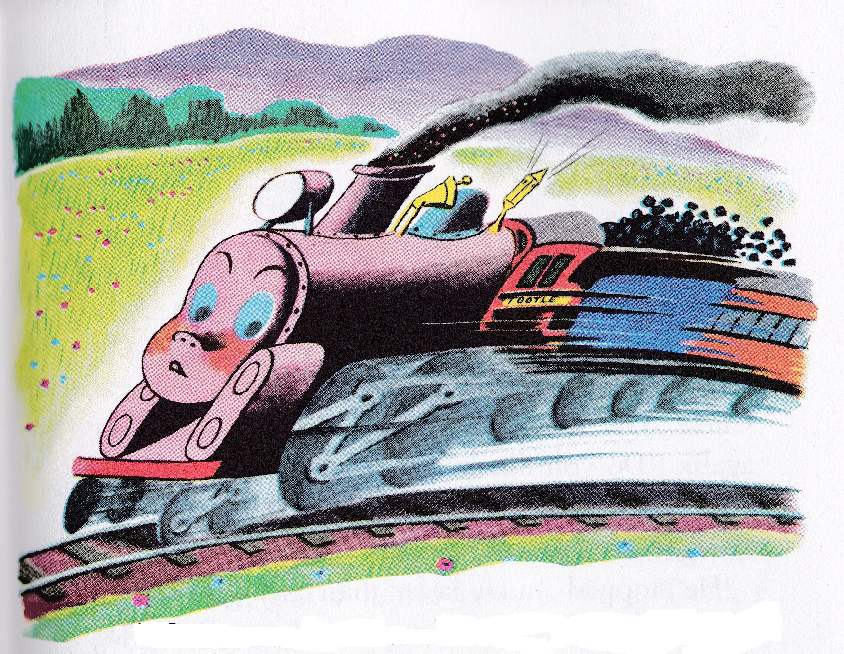
Notes:
“Tomorrow I will work hard,” decided Tootle. “I will not even think of leaving the rails, no matter what.”
Tootle was practicing Staying on the Rails No Matter What.
As he came to the Great Curve, Tootle looked across the meadow. It was full of buttercups.
“It’s like a big yellow carpet. How I should like to play in them” thought Tootle.
He hopped off the tracks and bumped along the meadow to the yellow buttercups.

Slide 12
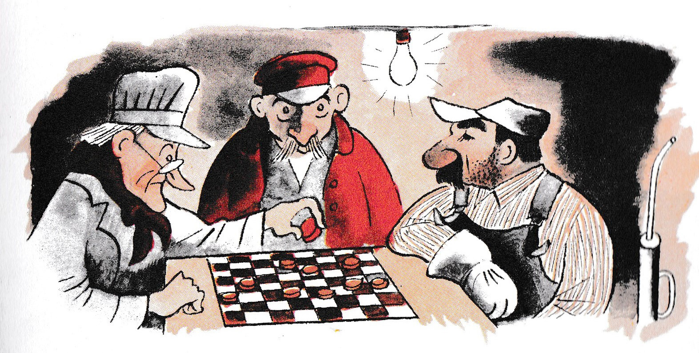
Notes:
That evening while the Chief Oiler was playing checkers with old Bill, he said, “It’s strange. It’s very strange, but I found grass between Tootle’s front wheels today.”
Bill’s face was stern. “Tootle knows he must get 100 A+ in Staying on the Rails No Matter What, if he is going to be a Flyer.”

Slide 13
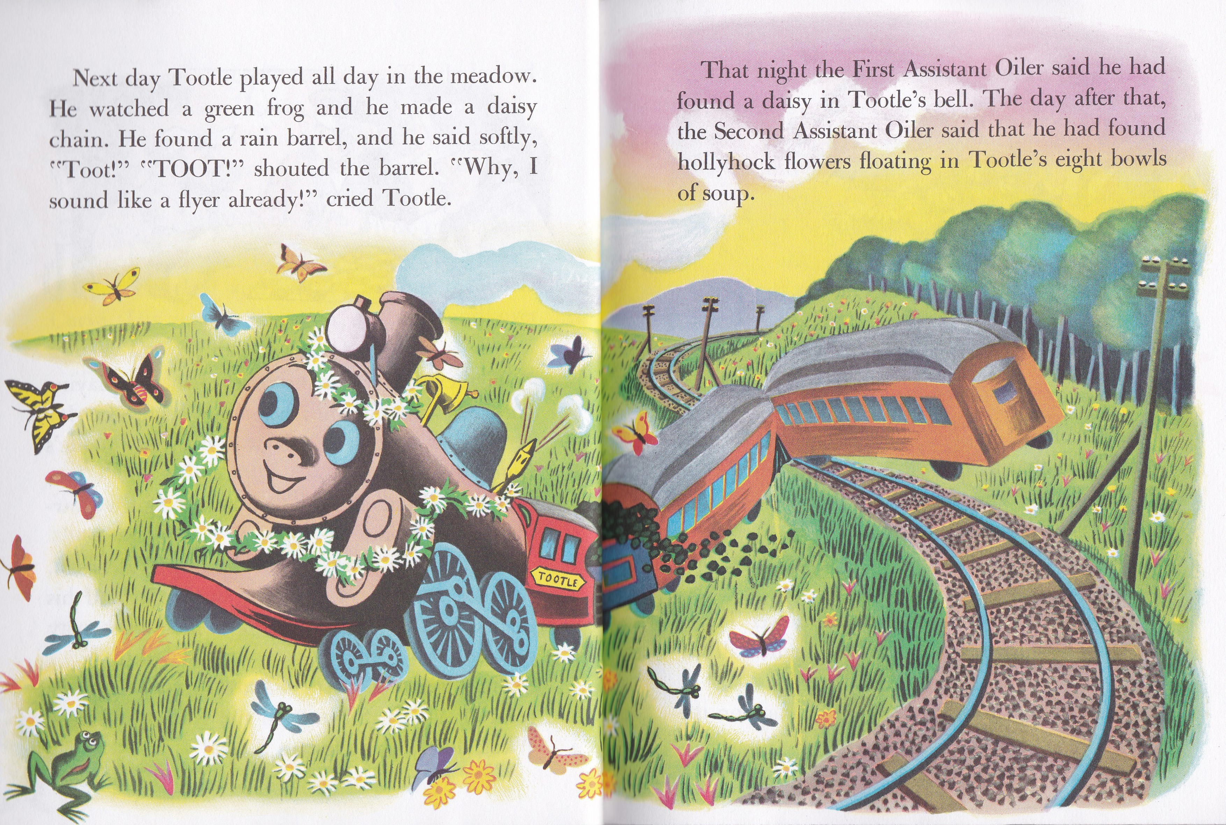
Notes:
Next day Tootle played all day in the meadow. He found a rain barrel, and he said softly, “Toot!’ “TOOT!” shouted the barrel. “Why, I sound like a Flyer already!” cried Tootle.
That night the First Assistant Oiler said he had found a daisy in Tootle’s bell. The day after that, the Second Assistant Oiler said that he had found hollyhock flowers floating in Tootle’s eight bowls of soup.

Slide 14
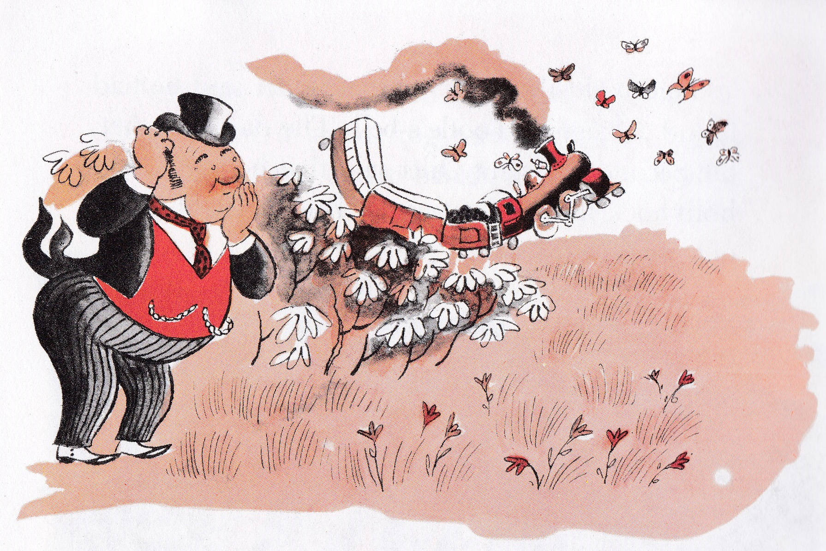
Notes:
Early one morning Bill had a long, long talk with the Mayor Himself.
When the Mayor Himself left the Lower Trainswitch School for Locomotives, he laughed all the way to the village.
“Bill’s plan will surely put Tootle back on the track,” he chuckled.

Slide 15
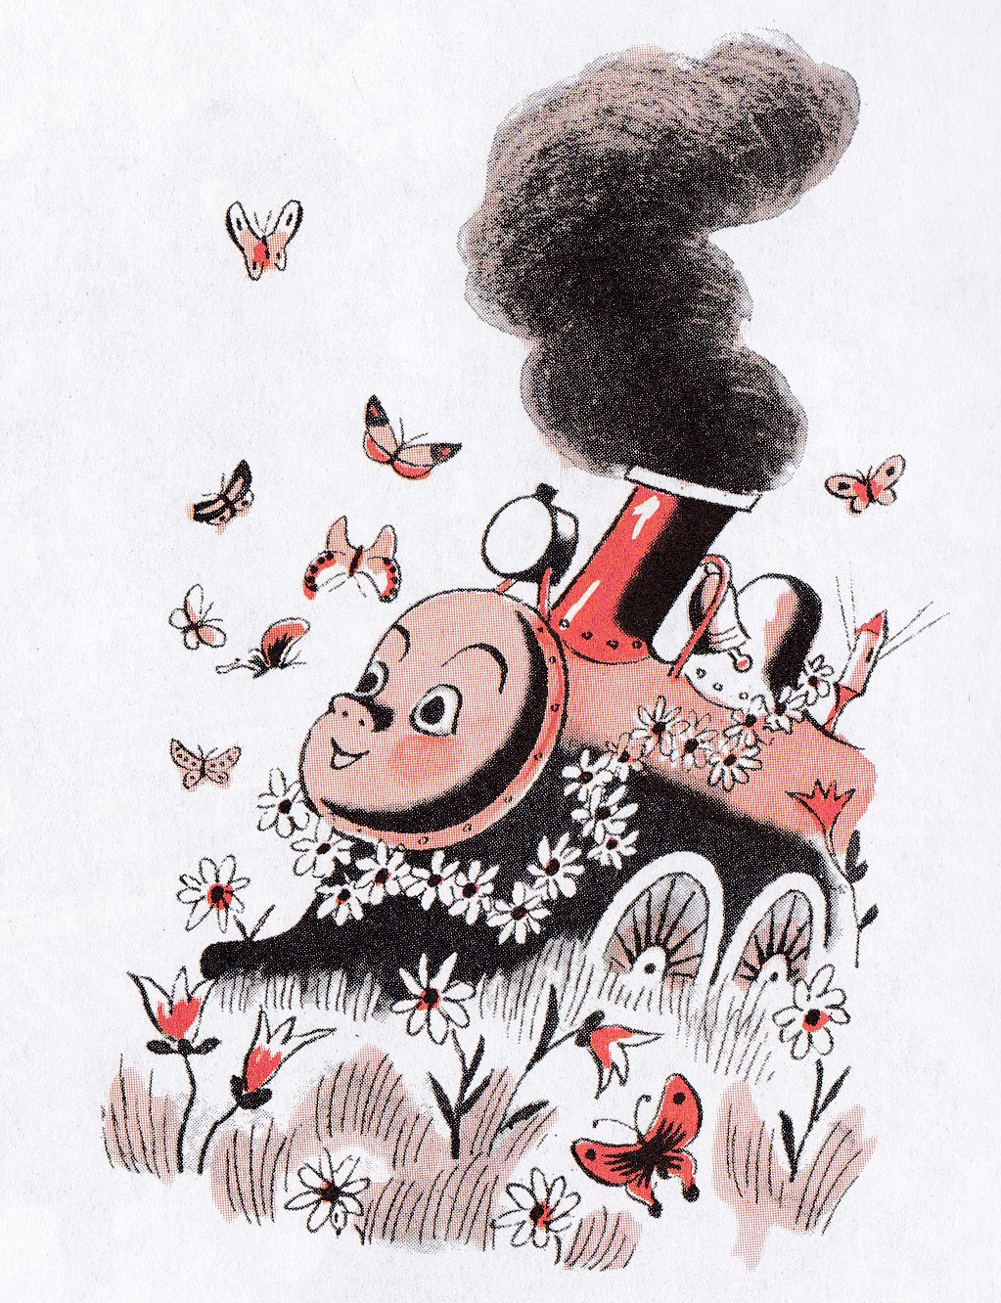
Notes:
Bill ran from one store to the next, buying ten yards of this and twenty yards of that and all you have of the other. The Chief Oiler and the First, Second Third Assistant Oilers were hammering and sawing instead of oiling and polishing. And Tootle? Well, Tootle was in the meadow watching the butterflies flying and wishing he could dip and soar as they did.

Slide 16
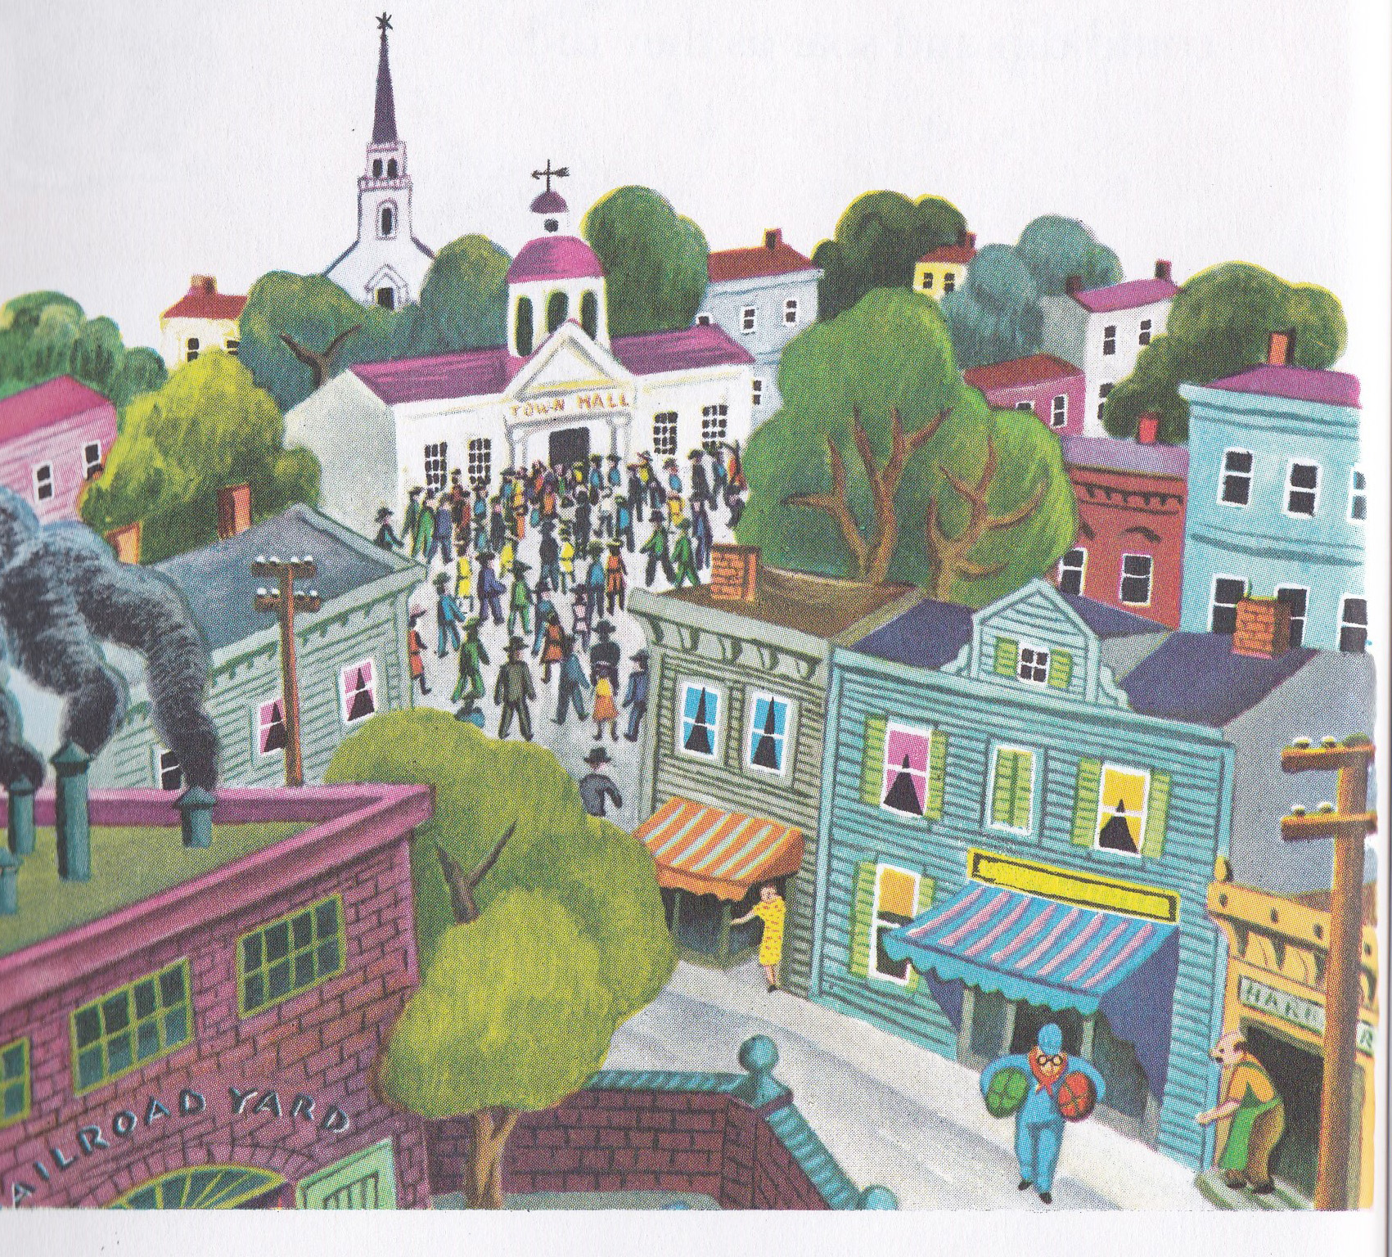
Notes:
Not a store in Lower Trainswitch was open the next day and not a person was at home. By the time the sun came up, every villager was hiding in the meadow along the tracks. And each of them had a red flag.

Slide 17
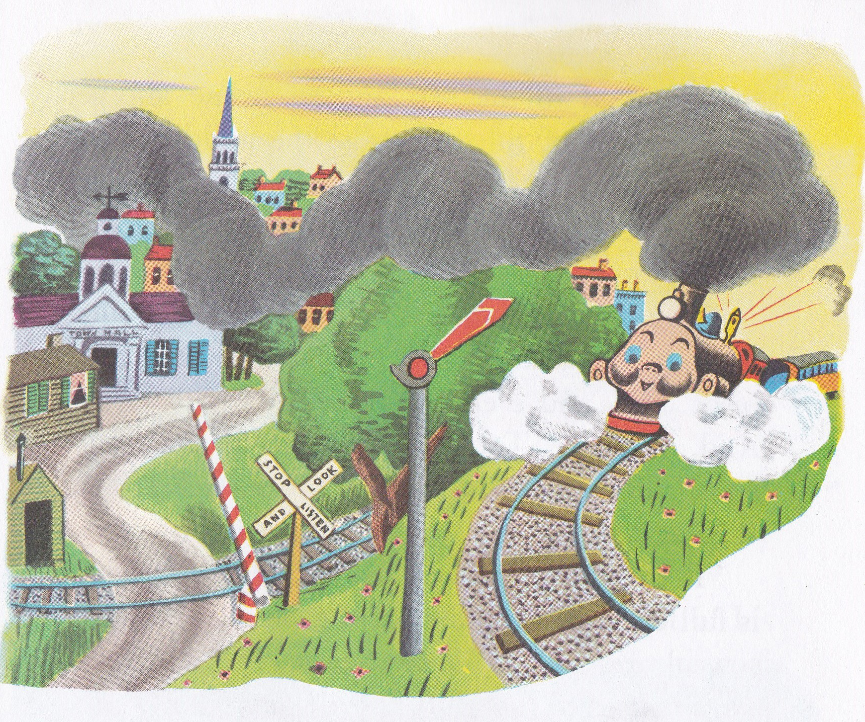
Notes:
Soon Tootle came tootling happily down the tracks. When he came to the meadow, he hopped off the tracks and rolled along the grass. Just as he was thinking what a beautiful day it was, a red flag poked up from the grass and waved hard. Tootle stopped, for every locomotive knows he must Stop for a Red Flag Waving.
“I’ll go another way,” said Tootle.

Slide 18
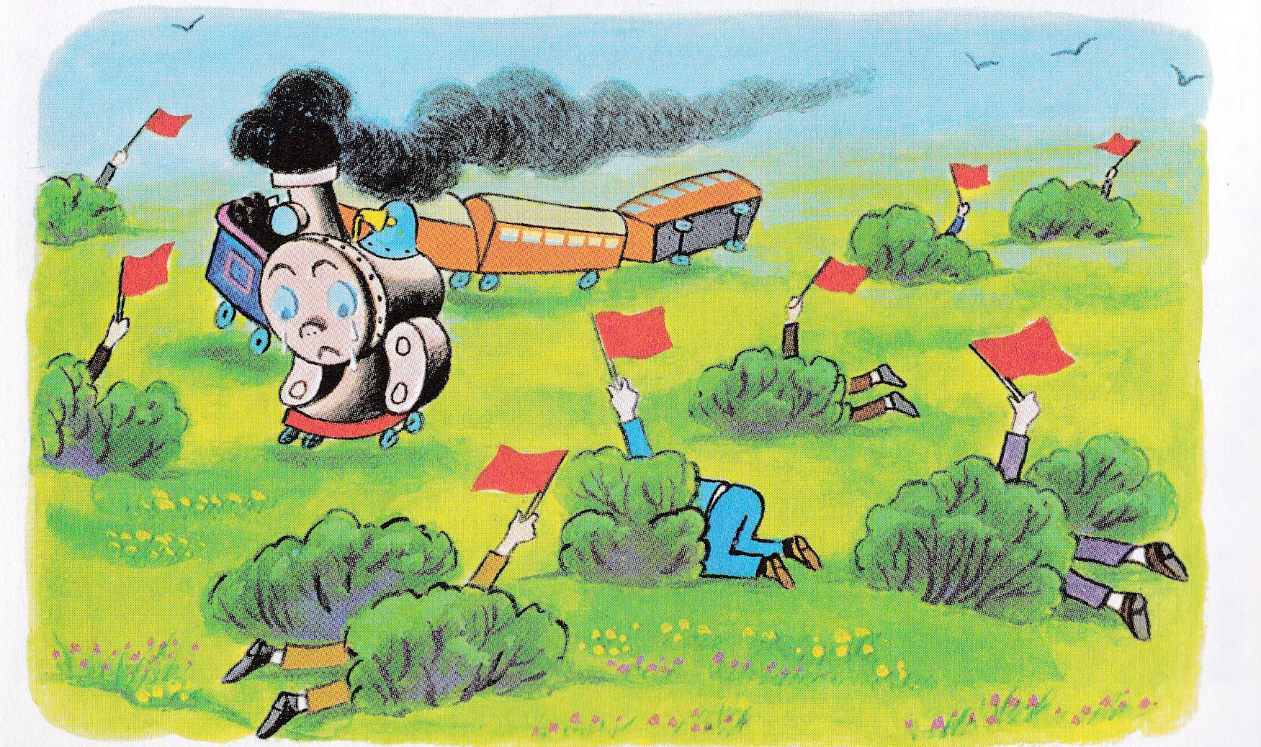
Notes:
He turned to the left, and up came another waving red flag, this time from the middle of the buttercups.
When he went to the right, there was another red flag waving.
There were red flags waving EVERYWHERE. And, of course, Tootle had to step for each one, for a locomotive must always Step for a Red Flag Waving.
“Red flags,” muttered Tootle. “This meadow is full of red flags. How can I have any fun?”

Slide 19
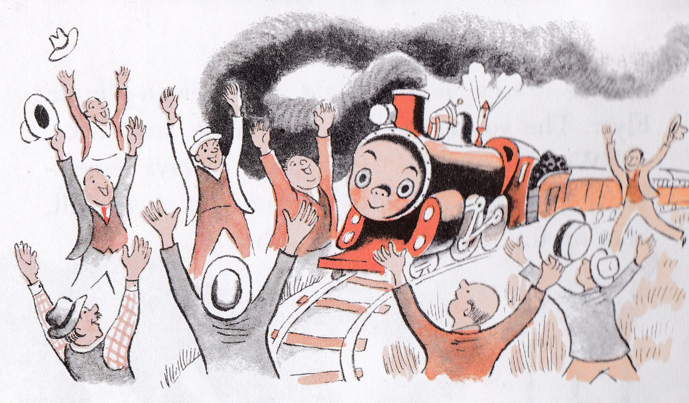
Notes:
“Whenever I start, I have to stop. Why did I think this meadow was such a fine place? Why don’t I ever see a green flag?”
Tootle happened to look back over his coal car. On the tracks stood Bill, and in his hand was a big green flag. “Oh!” said Tootle.
He puffed up to Bill and stopped.
“This is the place for me,” said Tootle. “There is nothing but red flags for locomotives that get off their tracks.:
“Hurray!” shouted the people of Lower Trainswitch, and jumped up from their hiding places. “Hurray for Tootle the Flyer!”

Slide 20
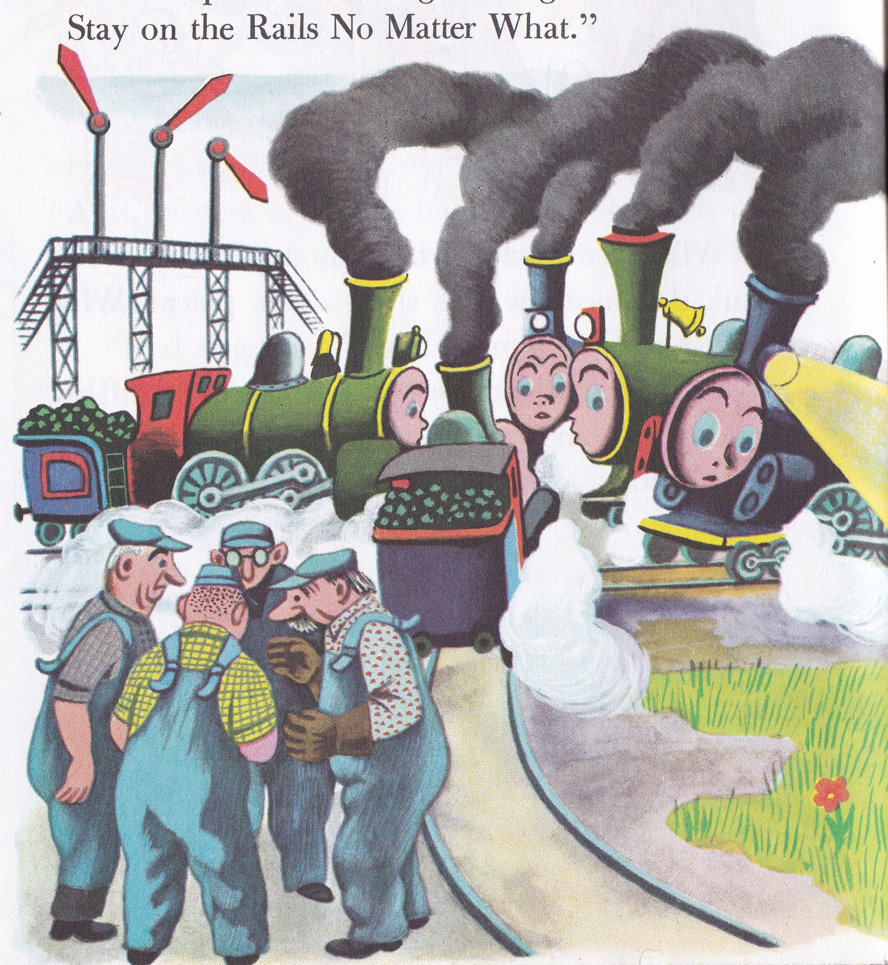
Notes:
Now Tootle is a famous Two-Miles-a-Minute Flyer. The young locomotives listen to his advice,
“Work hard,” he tells them. “Always remember to Stop for a Red Flag Waving. But most of all, Stay on the Rails No Matter What!”

Slide 21
God’s Desire for Our Lives
Notes:
Some people scoffed at the book: denying independence and being a free spirit
Bought into the lie: that LIFE can be found in the meadow, racing horses and making daisy chains among the buttercups.
If you’re a train and you go off the rails, you don’t have a good time playing in the meadow—you get STUCK in the dirt! Ever heard the phrase “train wreck”? It’s what happens when a train doesn’t stay on the rails no matter what.
Trains weren’t made to run on grass, they were made to run on rails. Staying on the rails is the only way Tootle was going to be the Flyer between New York and Chicago!
God’s truth and precepts are like the rails. He wants us to have good lives!

Slide 22
God’s Desire for Our Lives
Deut 4:40 "So you shall keep His statutes and His commandments which I am giving you today, that it may go well with you and with your children after you, and that you may live long on the land which the LORD your God is giving you for all time.“
Deuteronomy 5:16
Deuteronomy 5:33
Deuteronomy 6:3
Deuteronomy 6:19
Deuteronomy 12:28
Notes:
Tootle may have felt free when he jumped the tracks, doing what he wanted to do, but he was never going to be a Flyer that way.
It would only go well for him when he stayed on the tracks.
This is the message of SIX TIMES in Deuteronomy that God tells His people He wants things to go well for them.

Slide 23
Freedom isn’t found in doing what we want to do. It’s the power to do what is right.
Notes:
Freedom isn’t found in doing what we want to do.
Doing what we want to do is license, anarchy, chaos
Judges: every man did what was right in his own eyes
Freedom for Tootle came from staying on the rails. Freedom for us comes from doing things God’s way.
It’s the power to do what is right.
This morning: Freedom from the Past, processing what we did or what was done to us that might have resulted in guilt and shame. How do we move from being caged by such heavy, painful feelings to experiencing the freedom Jesus bought for us?
Tonight: Freedom in our Present. There are so many tapes playing in our heads, and they hold us captive with Lies and Deceptions. We need to replace them with God’s truth so we start seeing ourselves as we really are and living in freedom.
Sunday morning: Freedom Through Forgiveness. The single biggest obstacle to experiencing freedom is either needing to know we are forgiven, or needing to let go of unforgiveness toward someone who hurt us.
Sunday night: Freedom in Our Future. So many of us are shackled by fear, which manifests in perfectionism and being controlling. We’ll talk about how to become the Proverbs 31 kind of woman who smiles at the future because she’s not afraid of it.

Slide 24
Guilt
Notes:
Many women are in bondage to two heavy and difficult emotions:
Guilt and

Slide 25
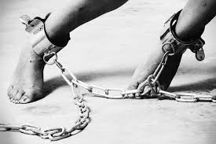
Shame
Notes:
Shame

Slide 26
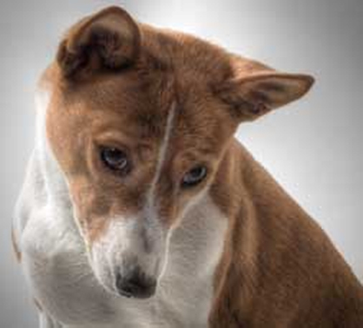
Guilt
Notes:
Guilt is the bad feeling we experience when we’ve done something wrong.
It’s like the red light on the dashboard of a car telling us something needs attention, there’s a problem.

Slide 27
Guilt is what we feel when we think we have broken a rule or fallen short of a standard.
Emotional / Logical
Perception / Reality
Notes:
Guilt is what we feel when we think we’ve broken a rule or fallen short of a standard.
Can be emotional rather than logical (feelings vs. objective truth)
Can be based on perception rather than reality (false guilt vs. true guilt)

Slide 28
Guilt can be both a fact and a feeling
Be guilty and not feel guilty
Feel guilty and not be guilty
Notes:
Guilt can be both a fact and a feeling; the two aren’t necessarily related.
We can be guilty and not feel guilty (psychopath - break law we disagree with)
We can feel guilty and not be guilty (abused as a child)
Feelings are real but they are not reliable.

Slide 29
True guilt
Pushes us to God
Leads to joy, peace, grace, love.
Confession and receiving God’s forgiveness and cleansing
If we confess our sins, God is faithful and just to forgive us our sins and cleanse us from all unrighteousness. (1 John 1:9)
Notes:
True guilt:
pushes us to God to confess, receive forgiveness and cleansing, and be reconciled to Him. (Like a toddler with a wet or dirty diaper who runs to mama to clean him up)
Leads to joy, peace, grace, love.
We deal with guilt by confessing our sins and receiving God’s forgiveness and cleansing
If we confess our sins, God is faithful and just to forgive us our sins and cleanse us from all unrighteousness. (1 John 1:9) (Note the verbs: we confess, God does 2 things.)

Slide 30
False guilt
Keeps us away from God
Focused on ourselves
Leads to despair, discouragement, depression, disappointment
Godly sorrow brings repentance that leads to salvation and leaves no regret, but worldly sorrow brings death. (2 Corinthians 7:10)
Notes:
False guilt:
keeps us away from God,
focused on ourselves and our shortcomings.
Leads to despair, discouragement, depression, disappointment
Godly sorrow brings repentance that leads to salvation and leaves no regret, but worldly sorrow brings death. (2 Corinthians 7:10)

Slide 31
What’s in your bucket?
Was it really my responsibility?
Was it a choice I made, or was it done to me?
Take responsibility for your choices, let the rest go
Notes:
Caren’s Guilt Bucket:
Filled with things you feel guilty about
True guilt comes along and you can’t accept it; already full
You explode, you react defensively, you reject what is being said
Dump out the false guilt to make room for the true guilt
Was it really my responsibility?
Was it a choice I made, or was it done to me?
Take responsibility for your choices, let the rest go

Slide 32
Our goal is to be free of false guilt and respond appropriately to true guilt.
Accept your strengths and weaknesses/limitations
Expect to do your best
Accept your own past mistakes
Notes:
Develop realistic expectations and getting rid of the guilt-producing ones:
Accept your strengths and weaknesses/limitations
Expect to do your best rather than be the best
Accept your own past mistakes and unfulfilled expectations, releasing them to God

Slide 33
Our goal is to be free of false guilt and respond appropriately to true guilt.
Discard others’ expectations
Don’t compare yourself
Discern what you value and esteem
Seek to know God and embrace His grace
Notes:
Discard others’ unrealistic or inapplicable expectations (whether from people, the media, or society)
Don’t compare yourself to others or expect perfection
Discern what you value and esteem (rather than be overly influenced by cultural expectations and others’ opinions)
Seek to know God and embrace the grace He gives

Slide 34
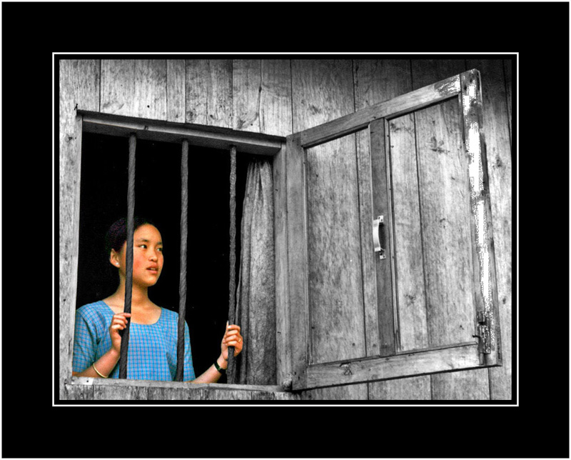
In bondage to guilt and regret?
“I am guilty” | “YOU ARE FORGIVEN”
“I am dirty” | “YOU ARE CLEANSED”
Notes:
I am guilty |
““God made Him who had no sin to be sin for u”s, so that in Him we might become the righteousness of God.” (2 Corinthians 5:21)
“If we confess our sins, He is faithful and just to forgive us our sins and cleanse us from all unrighteousness.” (1 John 1:9)
God says: “YOU ARE FORGIVEN”
----
I am dirty |
“But if we walk in the light, as he is in the light, we have fellowship with one another, and the blood of Jesus, his Son, purifies us from all sin.” (1 John 1:7)
God says: “YOU ARE CLEANSED FROM THE STAIN OF SIN WHEN YOU TRUST MY SON”

Slide 35
In bondage to guilt and regret?
“I am beating myself up” | “MY SON TOOK YOUR PUNISHMENT”
“My sin was awful” | “I KNOW HOW TO REDEEM.”
Notes:
“I am beating myself up” |
“There is therefore now no condemnation for those who are in Christ Jesus.” (Romans 8:1)
God says: “MY SON TOOK YOUR PUNISHMENT ON HIMSELF ON THE CROSS”
---
“My sin was awful” |
“And we know that God causes all things to work together for good to those who love God, to those who are called according to His purpose.” (Romans 8:28)
God says: “I KNOW HOW TO REDEEM. “

Slide 36
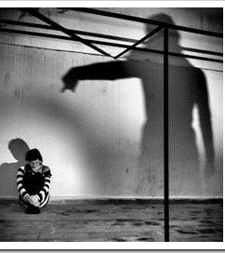
Shame
The heavy, dark feeling that says, “I AM something wrong.”
Notes:
Shame is the heavy, dark feeling we experience that says, “I AM something wrong.”

Slide 37
Shame is a sense of:
Exposure (“I am naked”)
Rejection (“I am an outcast, not good enough”)
Abandonment (“I am alone and disconnected”)
Contaminated (“I am dirty and unclean”)
Notes:
Exposure (“I am naked”)
Rejection (“I am an outcast, not good enough”)
Abandonment (“I am alone and disconnected”)
Contaminated (“I am dirty and unclean”)
We deal with true guilt by confessing and being forgiven,
but how do we confess and repent of what we ARE?
It’s not something we chose to be,
so how do we confess it?
The answer is, we can’t.
Shame needs to be dealt with differently than guilt.

Slide 38
Arrows in the heart generate lies
Notes:
When an arrow pierces our heart, it starts generating lies.
“I am bad.”
“I am damaged goods”
“I am lesser-than, other-than.”
“Never good enough”
My identity is “crippled girl.”
They don’t FEEL like lies, they feel like the truth. The question is, would God agree? Or does He see us differently?

Slide 39
Guilt and Shame
We deal with guilt by confessing our sin.
We deal with shame by focusing on the grace of God’s acceptance.
Notes:
We deal with true guilt by confessing our sin.
We deal with shame by focusing on the grace of God’s acceptance,
which neutralizes the lie that we are unacceptable and therefore worthy of rejection.

Slide 40
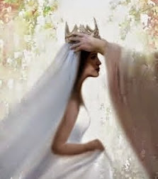
God heals our shame by replacing it with honor.
Notes:
God heals our shame by replacing it with honor.
Shame and honor are on opposite ends of the spectrum.

Slide 41
Jesus takes our guilt and shame into Himself,
and gives us His righteousness and holiness.
Notes:
Imagine your guilt and shame being transferred onto Jesus on the cross
His righteousness and holiness being transferred onto you.
That’s the “marvelous exchange.”
Unfair God? Absolutely!
Shame emerged from sin in the Garden of Eden.
Gen 3:6 When the woman saw that the tree was good for food, and that it was a delight to the eyes, and that the tree was desirable to make one wise, she took from its fruit and ate; and she gave also to her husband with her, and he ate.
Gen 3:7 Then the eyes of both of them were opened, and they knew that they were naked; and they sewed fig leaves together and made themselves loin coverings.
Gen 3:8 They heard the sound of the LORD God walking in the garden in the cool of the day, and the man and his wife hid themselves from the presence of the LORD God among the trees of the garden.

Slide 42
Exposure (“I am naked”) Clothed
Covered with royal priestly garments
The priests’ garments: glory, beauty and splendor
We have been given a royal wardrobe because our Father is the King!
“I HAVE COVERED YOU WITH MY ROYAL PRIESTLY GARMENTS OF GLORY, BEAUTY AND SPLENDOR.”
Notes:
So how do we experience freedom from the bondage of shame?
By replacing the lies with God’s truth.
LIE: “I am naked.” (You may FEEL naked and exposed, but feelings are real but not reliable.)
TRUTH:
Covered with royal garments
“You are a chosen race, a royal priesthood” (1 Peter 2:9)
The priests’ garments, the original designer clothing, instantly communicated glory, beauty and splendor
We have been given a royal wardrobe because our Father is the King!
God says: “I HAVE COVERED YOU WITH MY ROYAL PRIESTLY GARMENTS OF GLORY, BEAUTY AND SPLENDOR.”

Slide 43
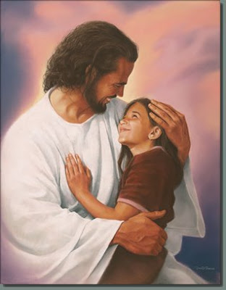
Rejection (“I am an outcast, not good enough”) Acceptance
Accepted in the Beloved, as children of the King (Ephesians 1:6, KJV)
Father has accepted us (Romans 14 :3)
Son has accepted us (Romans 15:7)
“I HAVE DECLARED YOU ACCEPTABLE AND ACCEPTED IN THE BELOVED.”
Notes:
LIE: I am rejected.
TRUTH:
We are accepted in the Beloved, as children of the King (Eph 1:6 KJV)
The Father has accepted us (Romans 14 :3)
Son has accepted us (Romans 15:7)
God says: “I HAVE DECLARED YOU ACCEPTABLE AND ACCEPTED IN THE BELOVED.”

Slide 44
Contaminated (“I am dirty and unclean”) Cleansed and Purified
Cleansed and purified
“[S]o that He might sanctify her, having cleansed her by the washing of water with the word…” (Ephesians 5:26)
“[W]ho gave Himself for us . . . to purify for Himself a people for His own possession” (Titus 2:14)
“I HAVE CLEANSED AND PURIFIED YOU.”
Notes:
LIE: I am contaminated
TRUTH:
I am cleansed and purified by Jesus
“[S]o that He might sanctify her, having cleansed her by the washing of water with the word…” (Ephesians 5:26)
“[W]ho gave Himself for us . . . to purify for Himself a people for His own possession” (Titus 2:14)
God says: “I HAVE CLEANSED AND PURIFIED YOU.”

Slide 45
Abandonment (“I am alone and disconnected”) Connected and loved
Connected to the Father face to face
The LORD bless you, and keep you; the LORD make His face shine on you, and be gracious to you; the LORD lift up His countenance on you, And give you peace. (Numbers 6:24-26)
He predestined us to adoption as sons through Jesus Christ to Himself, according to the kind intention of His will (Ephesians 1:5)
“I HAVE ADOPTED YOU INTO MY ROYAL FAMILY AND MADE YOU MY PRINCESS”
Notes:
LIE: I will be abandoned
TRUTH:
Connected to the Father face to face
The LORD bless you, and keep you; the LORD make His face shine on you, and be gracious to you; the LORD lift up His countenance on you, And give you peace. (Numbers 6:24-26)
He predestined us to adoption as sons through Jesus Christ to Himself, according to the kind intention of His will (Ephesians 1:5)
God says: “I HAVE ADOPTED YOU INTO MY ROYAL FAMILY AND MADE YOU MY PRINCESS”
Time for The Wemmicks?

Slide 46
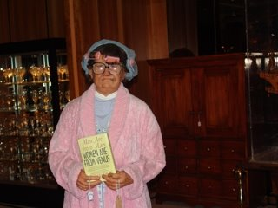
Notes:
One of my mentors told me he was counseling a lady about how to deal with her shame.
He likened it to a nasty, grungy, sticky smelly old bathrobe.
When he asked her if she'd like to take it off, she shrank back and said, "NO!"
He asked why not, and she replied, "Because I'm not wearing anything underneath!"
And he was able to tell her,
"Oh yes, my dear, underneath that bathrobe of shame you have been clothed with the robe of righteousness!
Your shame is covering up what Jesus gave you, what He died to secure for you:
a bright and shining, beautiful robe of HIS righteousness."
The bathrobe came right off.

Slide 47
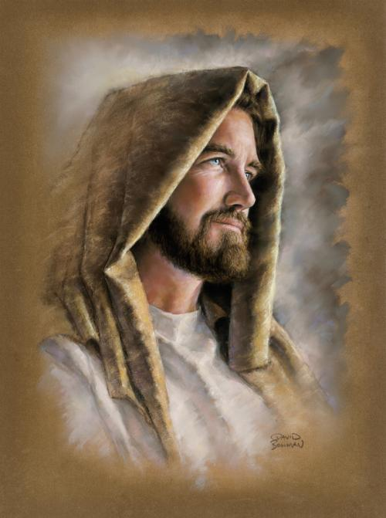
Notes:
The moment in a wedding ceremony where the bride and groom turn to face each other.
Jesus calls us His bride.
He turns to you as a sign of His favor.
You turn to Him and begin to reflect His beauty.
Turn to your King and receive freedom to replace your guilt and shame.
Turn to your King and find forgiveness, cleansing, acceptance, honor, worth and glory.

