Slide 1
Forgiveness LHM 2012
Sue Bohlin
Probe Ministries
www.probe.org
Suebohlin.com

Slide 2
Has anyone ever hurt you?
An arrow was lodged in your heart.
Arrows generate lies
Arrows generate pain
Notes:
Arrow is like a splinter in the soul → infection, pus

Slide 3
What forgiveness feels like

Slide 4
“How do You bring emotional healing?”
Grieving
Forgiving
Notes:
Not easy, but simple
Grieving—get the tears from the inside to the outside.
Limited number of tears
Crying, journaling, screaming, punching

Slide 5
The Jewish perspective on forgiveness: if the offender hasn’t repented, you don’t have to forgive.
NT: Forgiveness is completely dependent on us.

Slide 6
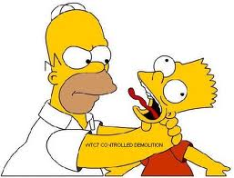
Forgiving: letting go of my right to see you suffer for what you did to me.
Removing your hands from the other person’s throat

Slide 7
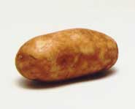
“LETTING GO”
Notes:
Letting go of the hot potato is forgiveness. Hanging onto the hot potato is unforgiveness.
Jesus: I have asbestos hands—give Me your potato!
Physical hot potato cools down.
Emotional hot potato gets hard, like cement inside us.

Slide 8
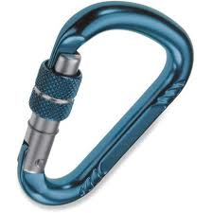
“LETTING GO”
Notes:
Letting go of the hot potato is forgiveness. Hanging onto the hot potato is unforgiveness.
Jesus: I have asbestos hands—give Me your potato!
Physical hot potato cools down.
Emotional hot potato gets hard, like cement inside us.

Slide 9
Misunderstandings About Forgiveness
“Forgive and Forget”
Forgiving is not trust
Forgiving is not reconciliation
Forgiving does not mean what they did was OK.
Forgiving doesn’t mean the offender gets away with it.
Notes:
Forgive and forget.
All memories are stored in the brain by electronic impulses and by chemical transference.
We are not commanded to “forgive and forget.”
Forgiveness is not trust.
Forgiveness is a gift; trust is earned.
Kevin doesn’t trust Jeremiah
Forgiveness is not reconciliation
Reconciliation takes two, not one
Rom 12:18 live at peace with all men
Forgiveness does not mean what they did was OK.
They hurt you. It wasn’t OK.
It was sin that required the death of Jesus.
Forgiving doesn’t mean the offender gets away with it.
Gal 6:7 Do not be deceived, God is not mocked; for whatever a man sows, this he will also reap.
“Somebody has to pay!” Jesus did.

Slide 10
Forgiveness means acknowledging the offense and then transferring the offender over to God in our hearts.
Forgiving someone means we deliberately choose to not to hold his offense against him and not to bring it up again.
In biblical Greek, forgive means “send away.”

Slide 11
Steps to Forgiveness
Acknowledge the offense
2. Turn the person over to God to repay them

Slide 12
The Jesus Jail

